Slide 1
LaplacesDemon
Package
Lecture 4

Slide 2
What does the Package Do
A general package in R which allows MCMC sampling to be conducted.
It includes several MCMC methods.
The function is written in R:
  Which is nice for debugging
  But horrible for speed.

Slide 3
Installing LaplacesDemon
Download the package:
http://www.bayesian-inference.com/softwaredownload
Install it:
install.packages(pkgs="path/LaplacesDemon_ver.tar.gz", repos=NULL, type="source")

Slide 4
Conducting Analysis
Specify the data, the parameters, and the outputs that should be summarized
Specify the model which computes the log-posterior (not the negative log-posterior).
Output the results and diagnostics.

Slide 5
Specifying the Data
Vector of names for quantities to be monitored
mon.names <- c(“LP”,”sigma”)
MyData <- list(mon.names=mon.names,
parm.names=parm.names, X=X, Y=Y)
Data
List of names of parameters
parm.names <- as.parm.names(list(alpha=0,beta=0,log.sigma=0))

Slide 6
Specifying a Model
Extract the parameters
Model <- function(parm,Data)
{
beta <- parm[1:2]
sigma <- exp(parm[3])
beta.prior <- dnormv(beta,0,1000,log=T)
sigma.prior <- dhalfcauchy(sigma, 25, log=TRUE)
mu <- beta%*%Data$X
LL <- sum(dnorm(Data$Y, mu, sigma, log=TRUE))
LP <- LL + sum(beta.prior) + sigma.prior
Modelout <- list(LP=LP, Dev=-2*LL, Monitor=
c(LP,sigma),yhat=rnorm(length(mu), mu, sigma), parm=parm)
return(Modelout)
}
Specify priors
Log Posterior
Deviance
For posterior predictive checks

Slide 7
Specifying a Model
You can impose bounds on parameters:
xx <- interval(parm[5], 1e-100,Inf)

Slide 8
Fitting the model-I
Fit <- LaplacesDemon(Model, Data=MyData, Initial.Values,
Covar=NULL, Iterations=150000, Status=50000,
Thinning=150,Algorithm="HARM", Specs=NULL)
Model and Data
Vector of Initial values
Number of Cycles
Frequency of reporting
Thinning Rate

Slide 9
Outputs from LapalcesDemon
To find out what is being stored from LaplacesDemon:
str(Fit)
The plot function has been overloaded – try it.

Slide 10
Parallel Chains on Multiple Computers!
Fit <- LaplacesDemon.hpc(Model, Data=MyData, Initial.Values,Covar=NULL, Iterations=150000, Status=50000, Thinning=150,Algorithm="HARM", Specs=NULL, Chains=4, CPUs=4, Packages=NULL, Dyn.libs=NULL)
Chains and CPUs

Slide 11
Methods
Laplace’s Demon includes many algorithms:
  Standard Metropolis-Hastings
  Adaptive MS
  Reversable Jump MCMC
Looks at the help for instructions – the options can be quite non-intuitive

Slide 12
Outputs (key)
Acceptance rate
DIC
Posterior samples
Monitoring output values
Try “Consort(Fit)” to see what Laplace’s Demon suggests for improving the sampling.

Slide 13
Diagnostics
Default plot:
  Trace plots
  Posterior densities
  Correlation plots
Posterior predictive checks
Caterpillar plots
caterpillar.plot(Fit.hpc,Parms=1:3)

Slide 14
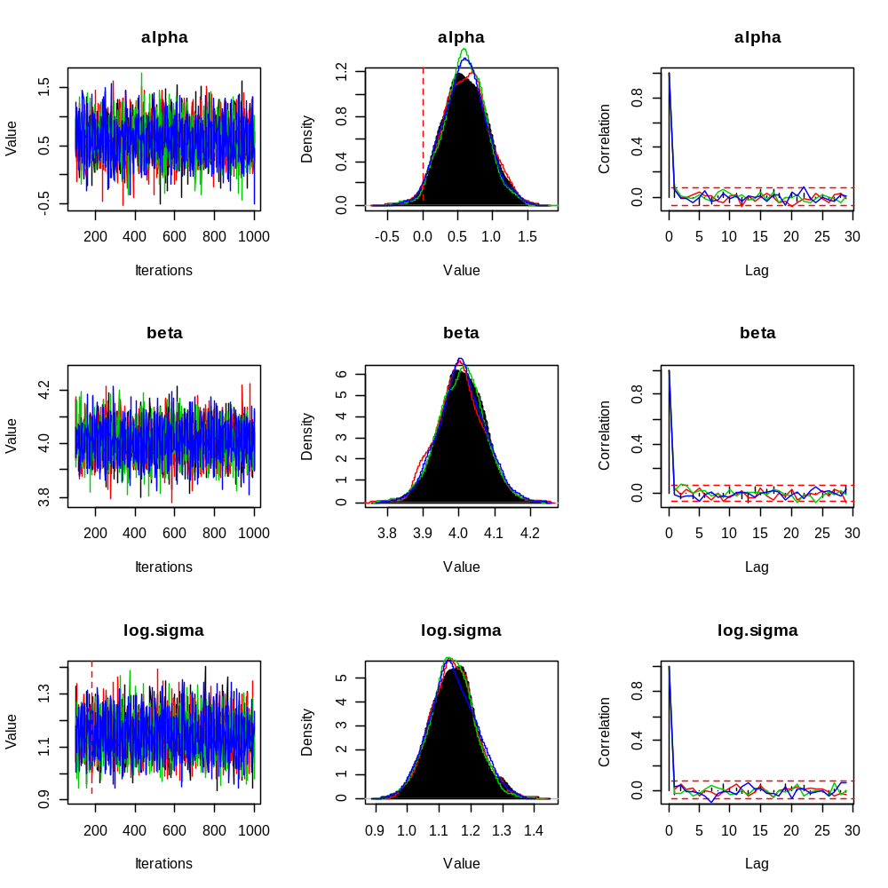
Inference based on four chains

Slide 15
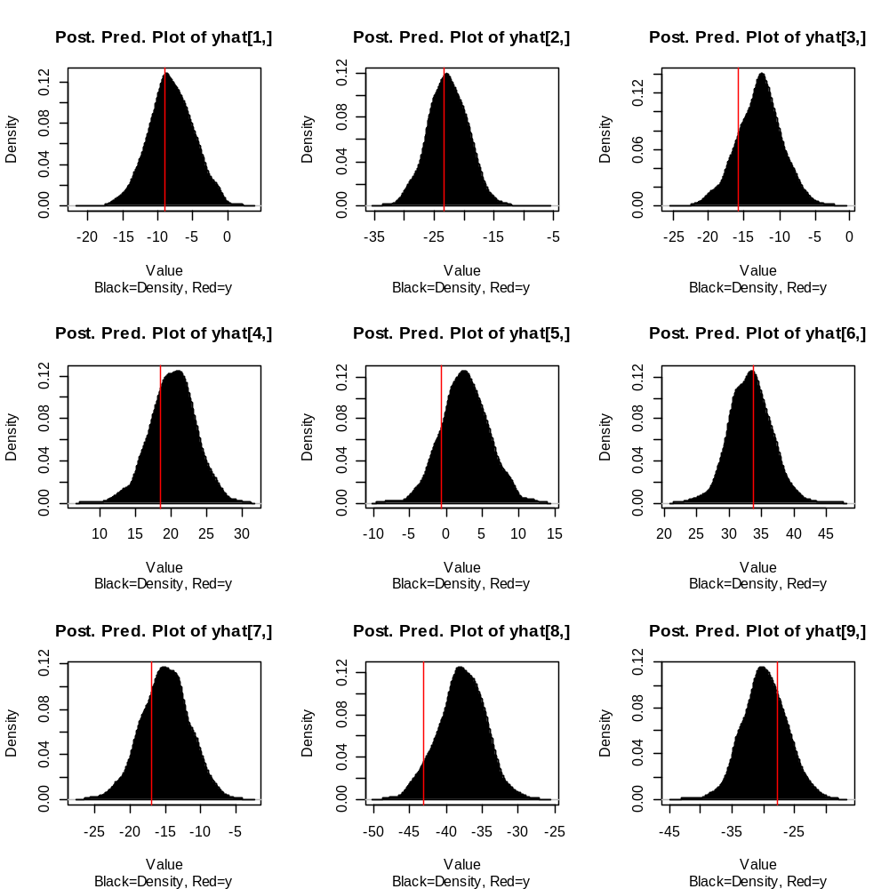

Slide 16
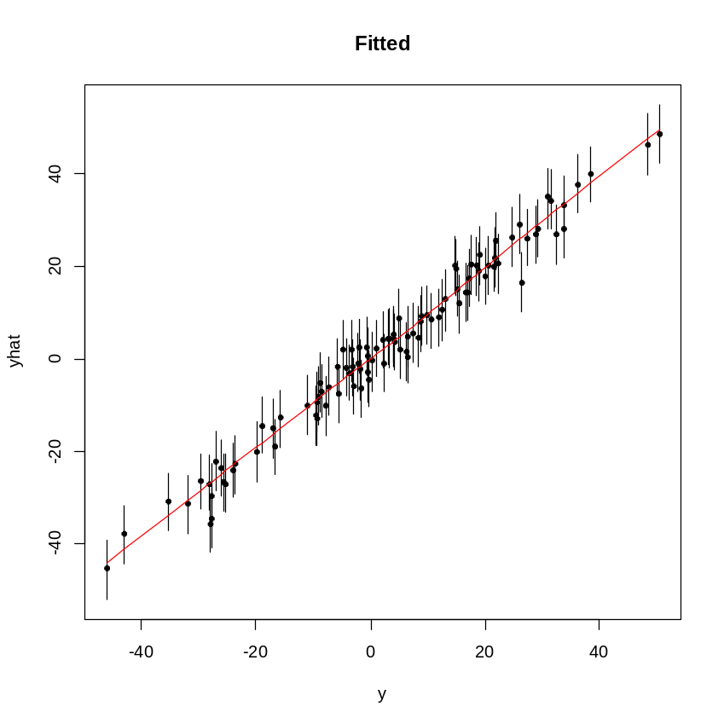
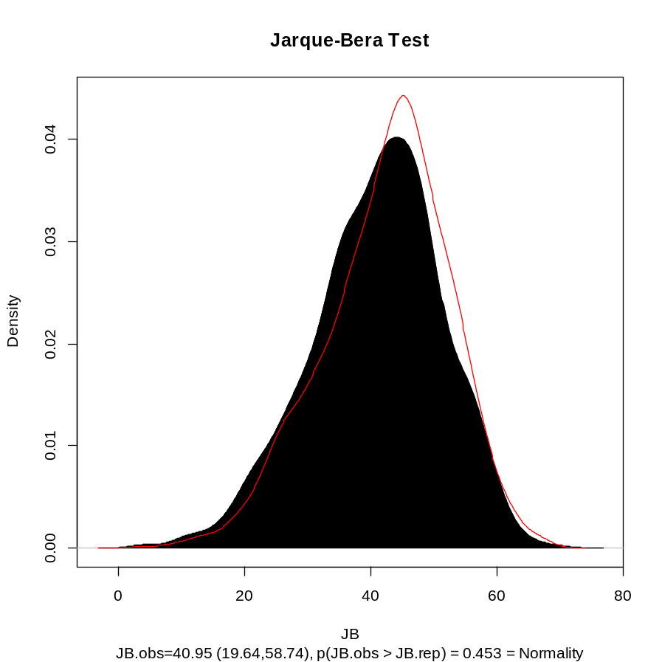
Posterior predictive checks

Slide 17
Other
The package is envolving:
  Look at (for example) BayesFactor
Lets look at two other examples:
  A reversible jump example
  A production model example.

Slide 18
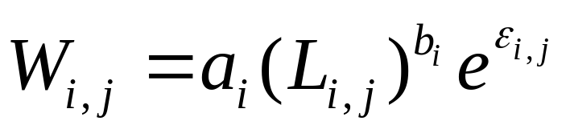
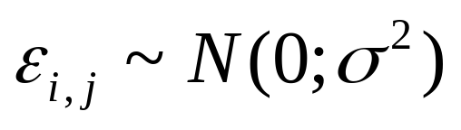
Example 2-I
15 populations were sampled for length and weight.
Each population was sampled 20 times.
The probability model for this problem is:

Slide 19
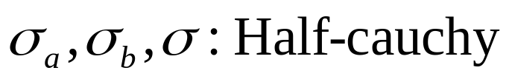
Example 2-II
The prior for this problem is:

Slide 20
Example 2-III
Use LaplaceDemon to:
  Sample parameters the posterior
  Summarize the outputs as posterior distributions
  Try some predictive checks

Slide 21

Never Forget..
The default seed in the manual is 666.
https://www.stonesthrow.com/images/2012/666.jpg

